Slide 1

WEEK 6
CESAR A. PASCAL

Slide 2
This week, the focus was on following the MJSwan workflow with the objective of understanding how a browser interface can load and run a MuJoCo simulation. The first step consisted of ensuring that the MuJoCo model values could be accessed and displayed in the browser, allowing them to be used later during the implementation stage.

Slide 3
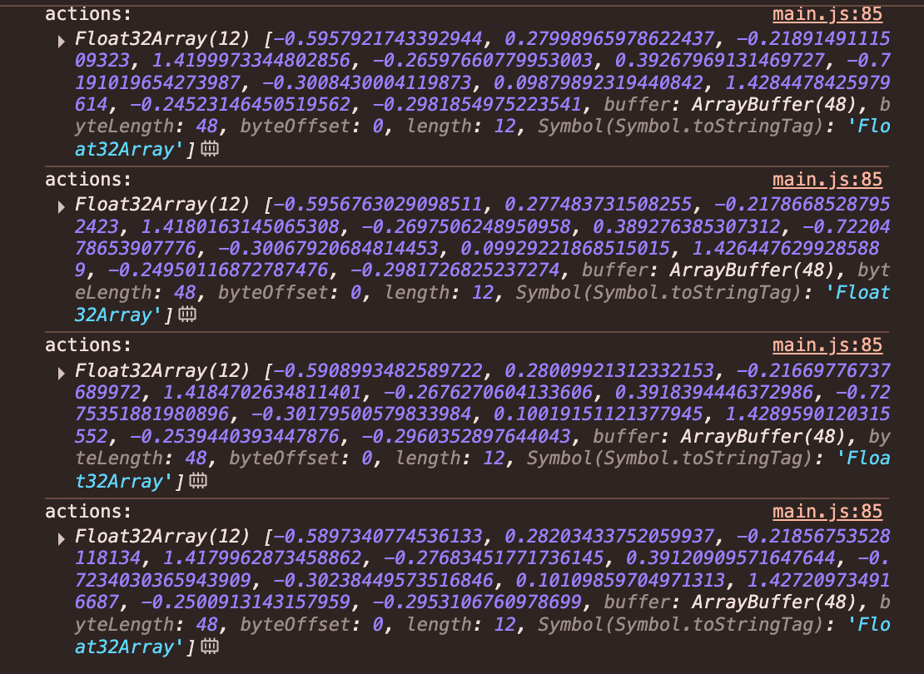
Initially, the MuJoCo model values were successfully exposed in the browser console, as shown below.

Slide 4
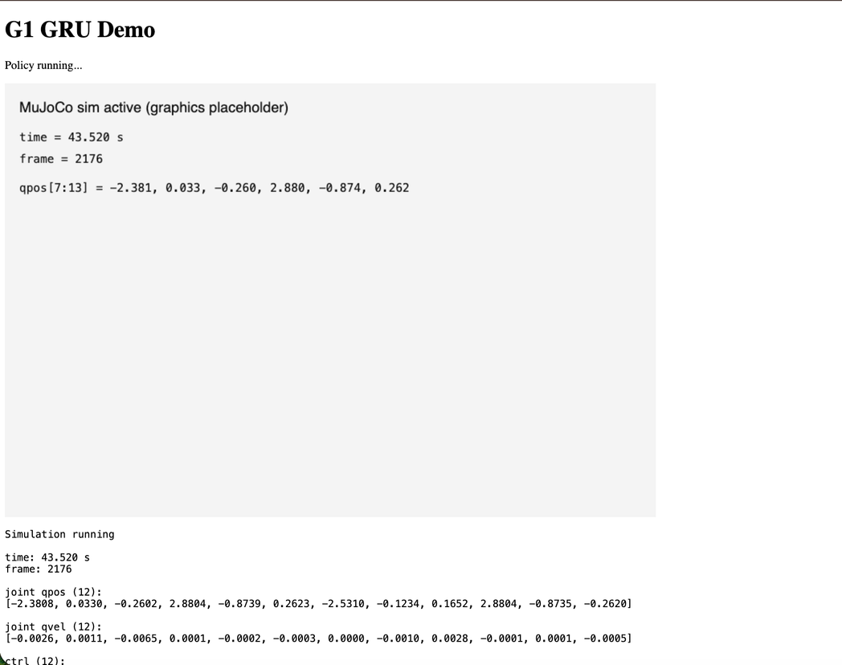
Afterward, it became possible to display these values on the main webpage and create a section that can later be used for running simulations.

Slide 5
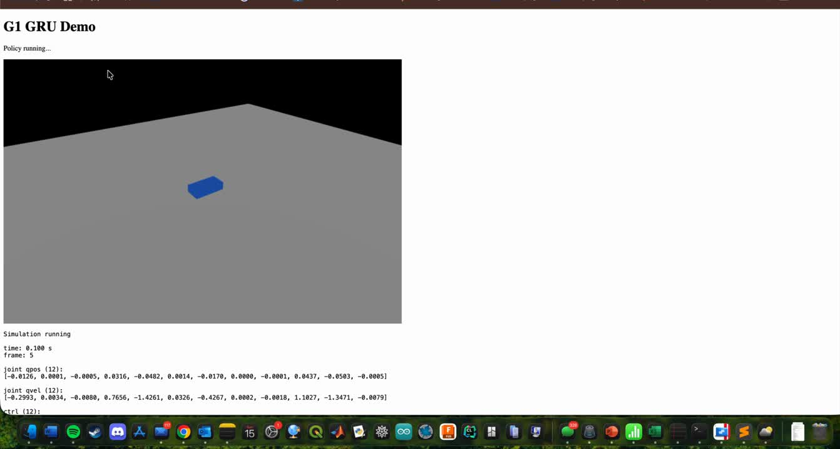
To test how the visualizer would function, I began with a simple moving blue box. This test was successful and confirmed that the visualization pipeline was working correctly. It is important to note that the model used was not trained, which explains the irregular movement observed.

Slide 6
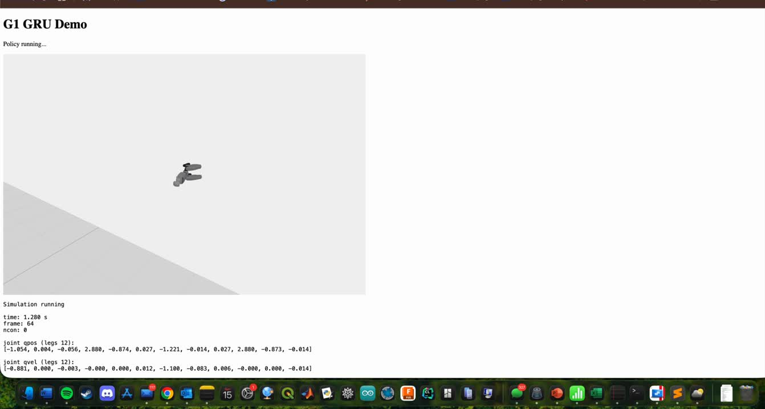
Following this, I worked on integrating a more humanoid model into the visualizer.

Slide 7
For future work, I will use GitHub to make the project function more like the original MJSwan and create a shareable link. In the current version, the browser interface runs on a local server, which means it can only be accessed from my computer.

Slide 8
Next Steps
  Create a GitHub repository to host the project and make the browser simulation accessible online instead of running only on a local server.
  Deploy the project using GitHub Pages to generate a shareable URL similar to the original MJSwan demos.
  Improve the visualizer interface to make the simulation more interactive, allowing users to better observe and control the behavior of the model.
  Continue studying the architecture of MJSwan to better understand how its simulation pipeline and browser integration work.
  Work on training and improving the locomotion model, with the goal of integrating a trained policy that produces more stable and realistic movements.
  Test the full pipeline (model → ONNX → browser inference → MuJoCo simulation) to ensure smooth real-time interaction.

Slide 9
References
MuJoCo. MuJoCo Physics Engine. https://mujoco.org/
ONNX. Open Neural Network Exchange (ONNX). https://onnx.ai/
ONNX Runtime Web. https://www.npmjs.com/package/onnxruntime-web
Three.js JavaScript 3D Library. https://threejs.org/
MuJoCo WebAssembly (mujoco-js / mujoco_wasm). https://github.com/zalo/mujoco_wasm
MJSwan: MuJoCo Web Simulation Framework. https://github.com/ttktjmt/mjswan
MJSwan Web Demo. https://ttktjmt.github.io/mjswan/
Unitree Robotics. Unitree G1 Humanoid Robot. https://www.unitree.com/

